Slide 1


Team Mini Project: Alternative Fueling Locations
Jalin Roberts | Eric Schneider

Slide 2


Tools Utilized
Pandas
Notes:
Tools utilized are the Pandas library within Python and Tableau for visualization

Slide 3
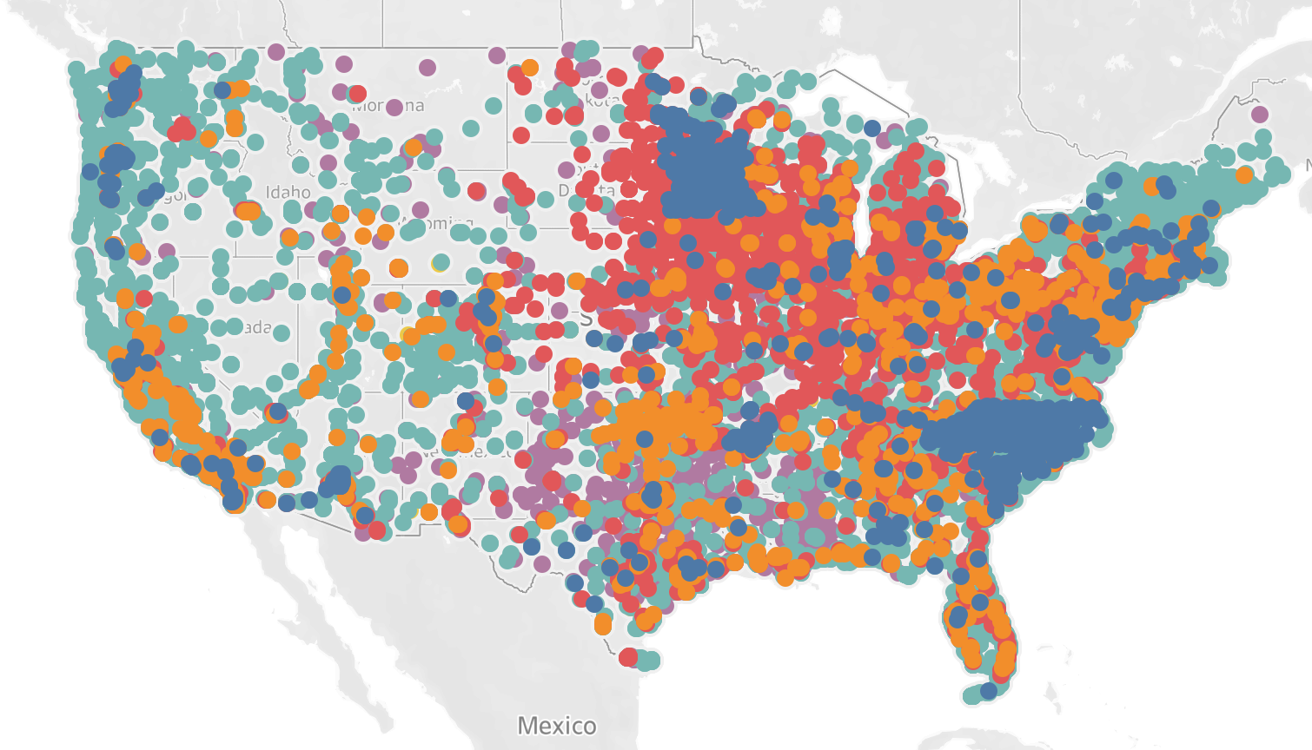
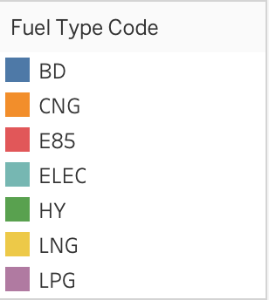
Alternative Fueling Points for United States
Notes:
Overview of visualization for AFL locations for the US as a whole, not shown are Alaska and Hawaii
These AFL locations were organized by Fuel Type Code

Slide 4
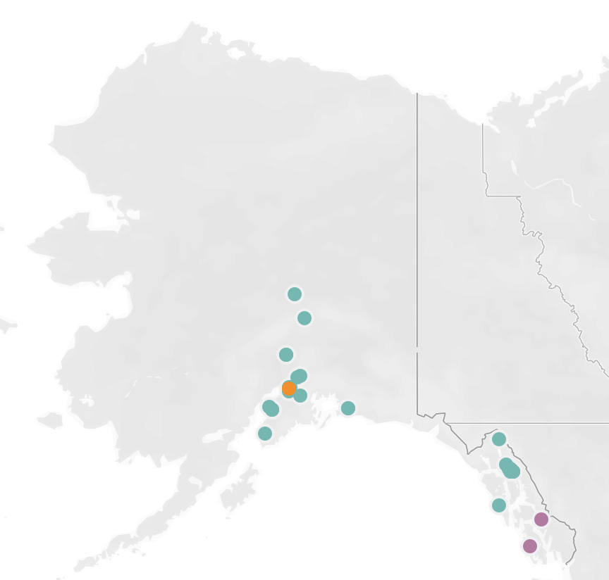
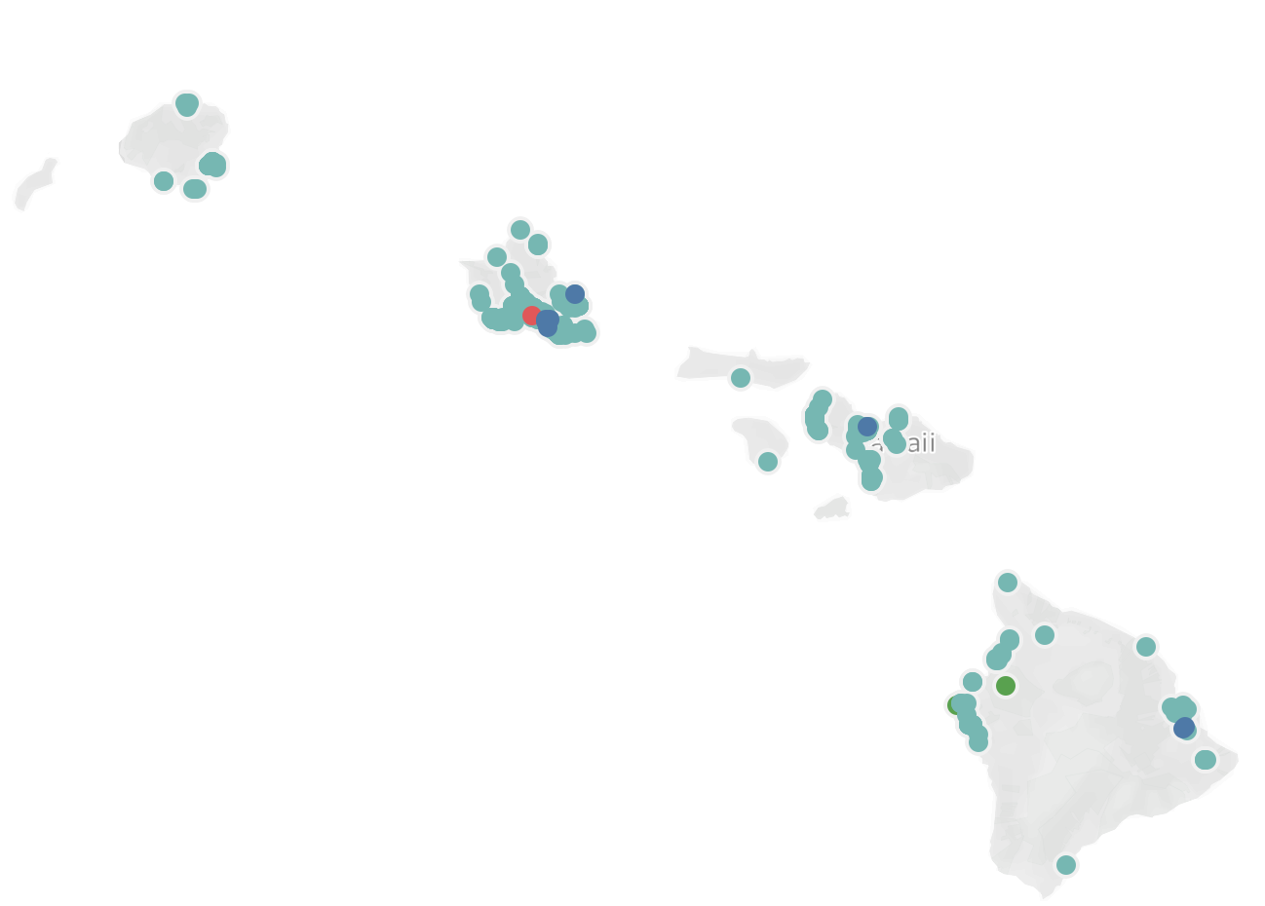
Alaska & Hawaii Alternate Fuel Locations
Notes:
Example of Alaska and Hawaii for reference

Slide 5
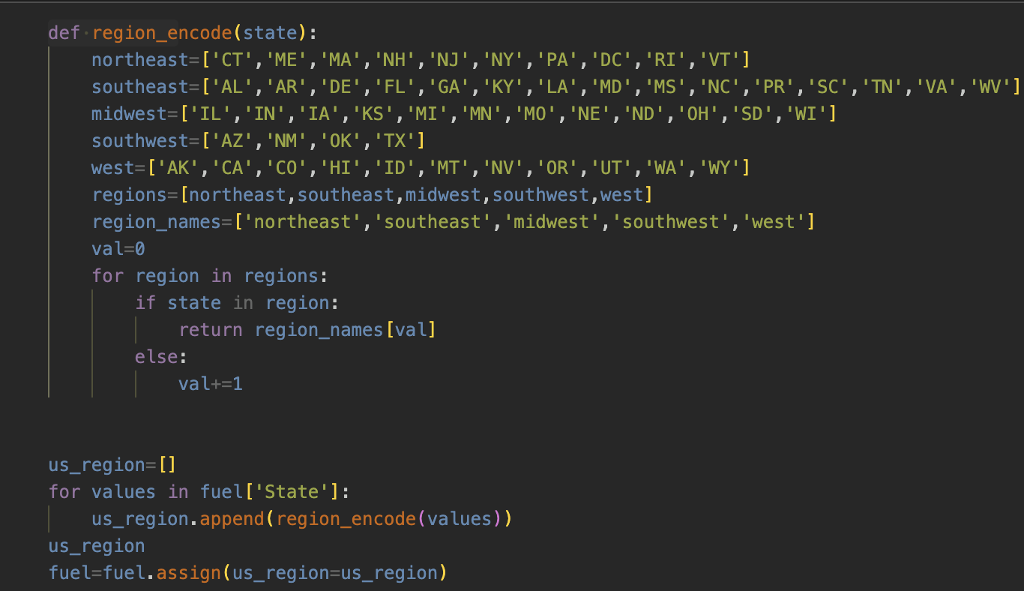
Code to assign states into respective regions
Notes:
Code necessary to encode the necessary data into region specific data that we can utilize.
Looked up each state as to its respective geographic location and assigned lists accordingly
The updated values are then assigned into a new value, and a .csv file is created to then work with

Slide 6
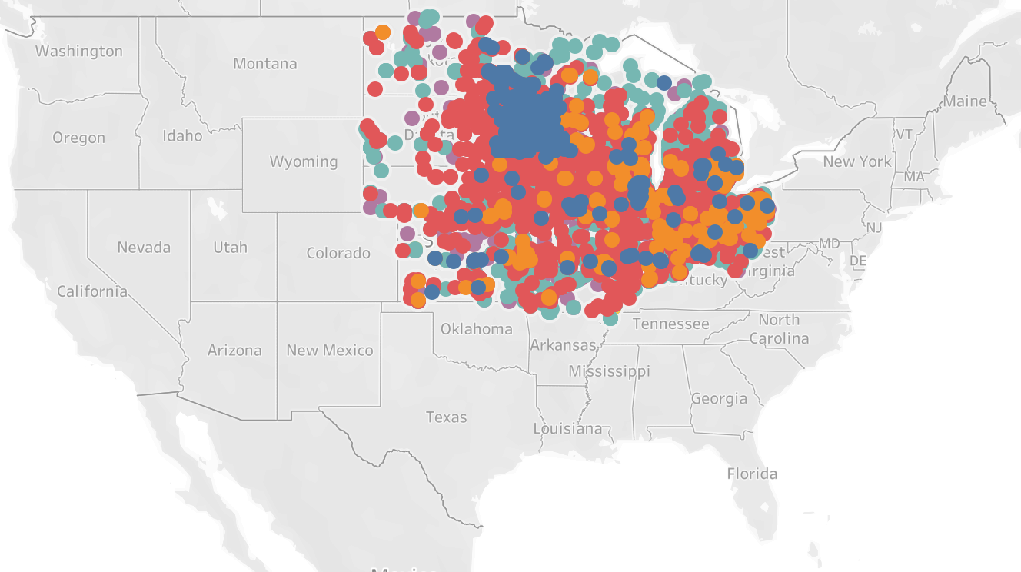
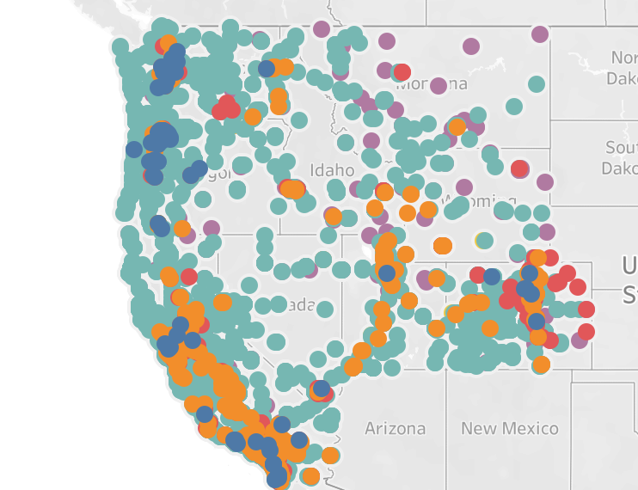
Regional Data highlights(Midwest and West shown)
Notes:
The visualization for this updated data encoding can be represented by our region specific data, they are also organized as part-to-a-whole graphs organized by Fuel Type Code.

Slide 7
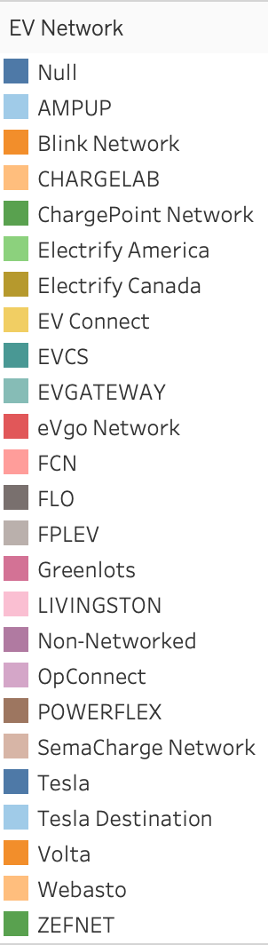
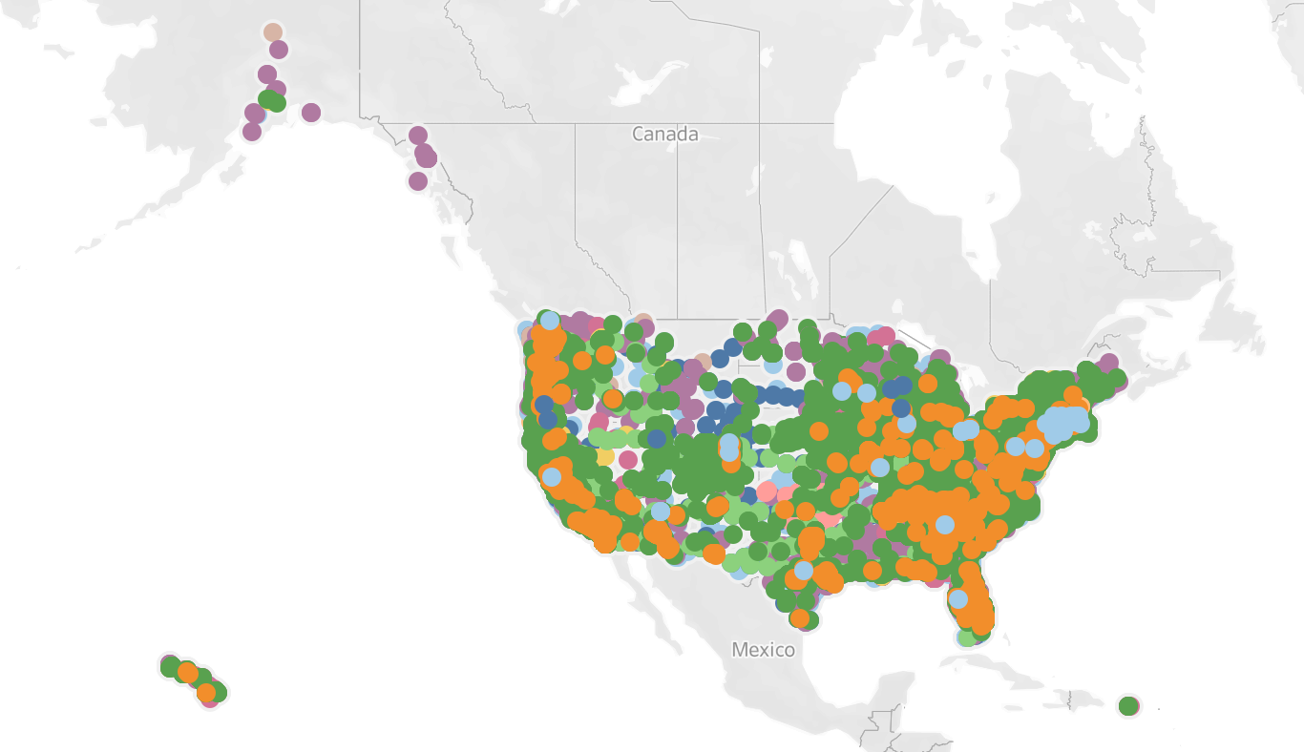
EV Network Locations

Slide 8
